Slide 1
Today
Greedy algorithms and the knapsack problem
Wrap-up

Slide 2
Designing algorithms is tricky!
No single recipe solves all our problems...
I ...but there are some useful principles
3 / 27

Slide 3
Designing algorithms is tricky!
No single recipe solves all our problems...
I ...but there are some useful principles
I “Divide and conquer” (e.g., merge sort)
I Greedy algorithms (today)
I Dynamic programming (for you to discover...)
3 / 27

Slide 4
Rough idea: make simple myopic decisions iteratively
Greedy algorithms
4 / 27

Slide 5
Greedy algorithms
Rough idea: make simple myopic decisions iteratively
Greedy algorithms are:
I Easy to come up with
I Easy to analyse in terms of running time
I Not always correct
4 / 27

Slide 6
Knapsack problem
Problem: fill a bag with the most valuable items available.
Input:
I Set of n items, with values v_{i} and sizes w_{i} (integer)
I Capacity W
5 / 27

Slide 7
Knapsack problem
Problem: fill a bag with the most valuable items available.
Input:
I Set of n items, with values v_{i} and sizes w_{i} (integer)
I Capacity W
Output: subset S of items that maximizes the sum of values subject to a capacity constraint:
I max ^{P}_{i2S} v_{i}
I subject to ^{P}_{i2S} w_{i} W
5 / 27

Slide 8

Knapsack problem applications
6 / 27

Slide 9
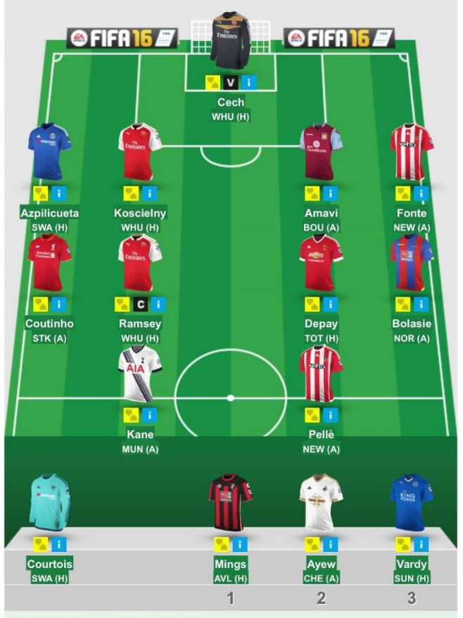
Knapsack problem applications
6 / 27

Slide 10
Knapsack problem applications
Many problems with budget constraints are versions of knapsack
I Selecting portfolios (eg projects to invest in)
I Lots of “operational” problems...
6 / 27

Slide 11
Two-item example
Items to pack
I Shirt: value 5, weight 5
I Bottle: value 10, weight 5
7 / 27

Slide 12
Two-item example
Items to pack
I Shirt: value 5, weight 5
I Bottle: value 10, weight 5
Subsets:
I {},{Shirt},{Bottle},{Shirt,Bottle}
7 / 27

Slide 13
Two-item example
Items to pack
I Shirt: value 5, weight 5
I Bottle: value 10, weight 5
Subsets:
I {},{Shirt},{Bottle},{Shirt,Bottle}
Knapsack size limits feasible solutions
I W < 5: can pick neither
I 5
W < 10: neither or just one
I W ≥ 10: all subsets feasible
7 / 27

Slide 14
Go through all possibilities?
Input:
I Set of n items, with values v_{i} and sizes w_{i} (integer)
I Capacity W
Output: subset S of items that maximizes the sum of values subject to capacity constraint:
I max ^{P}_{i2S} v_{i}
I subject to ^{P}_{i2S} w_{i} W
8 / 27

Slide 15
Go through all possibilities?
Input:
I Set of n items, with values v_{i} and sizes w_{i} (integer)
I Capacity W
Output: subset S of items that maximizes the sum of values subject to capacity constraint:
I max ^{P}_{i2S} v_{i}
I subject to ^{P}_{i2S} w_{i} W
Exhaustive (brute-force) search?
I Go through all subsets of {1, 2, 3, ..., n}
I Suppose we have 50 items: O(2^{n} ) subsets...
8 / 27

Slide 16
Greedy approaches for knapsack problem
Input:
I Set of n items, with values v_{i} and sizes w_{i}
I Capacity W
Output: subset S of items that maximizes the sum of values subject to capacity constraint:
I max ^{P}_{i2S} v_{i}
I subject to ^{P}_{i2S} w_{i} W
Greedy approaches? — Pick myopically without worrying about future choices
9 / 27

Slide 17
Greedy approaches for knapsack problem
Input:
I Set of n items, with values v_{i} and sizes w_{i}
I Capacity W
Output: subset S of items that maximizes the sum of values subject to capacity constraint:
I max ^{P}_{i2S} v_{i}
I subject to ^{P}_{i2S} w_{i} W
Greedy approaches? — Pick myopically without worrying about future choices
I Highest-value item first?
9 / 27

Slide 18
Greedy approaches for knapsack problem
Input:
I Set of n items, with values v_{i} and sizes w_{i}
I Capacity W
Output: subset S of items that maximizes the sum of values subject to capacity constraint:
I max ^{P}_{i2S} v_{i}
I subject to ^{P}_{i2S} w_{i} W
Greedy approaches? — Pick myopically without worrying about future choices
I Highest-value item first?
I Lowest-size item first?
9 / 27

Slide 19
Greedy approaches for knapsack problem
Input:
I Set of n items, with values v_{i} and sizes w_{i}
I Capacity W
Output: subset S of items that maximizes the sum of values subject to capacity constraint:
I max ^{P}_{i2S} v_{i}
I subject to ^{P}_{i2S} w_{i} W
Greedy approaches? — Pick myopically without worrying about future choices
I Highest-value item first?
I Lowest-size item first?
I Some easy way of combining value and size?
9 / 27

Slide 20
Greedy algorithms for knapsack
Greedy approaches?
I Highest-value item first?
10 / 27

Slide 21
Greedy algorithms for knapsack
Greedy approaches?
I Highest-value item first?
Example: capacity W = 20, three items with values v = [10, 10, 11], weights
w = [10, 10, 11].
I Picking highest value first is bad...
10 / 27

Slide 22
Greedy algorithms for knapsack
Greedy approaches?
I Highest-value item first?
I Lowest-size item first?
Example: capacity W = 20, three items with values v = [10, 10, 11], weights
w = [10, 10, 11].
I Picking highest value first is bad...
10 / 27

Slide 23
Greedy algorithms for knapsack
Greedy approaches?
I Highest-value item first?
I Lowest-size item first?
Example: capacity W = 20, three items with values v = [10, 10, 11], weights
w = [10, 10, 11].
I Picking highest value first is bad...
Example: capacity W = 20, three items with values v = [10, 10, 50], weights
w = [10, 10, 11].
I Picking lowest weight first is bad...
10 / 27

Slide 24
Greedy algorithms for knapsack
Greedy approaches?
I Highest-value item first?
I Lowest-size item first?
Example: capacity W = 20, three items with values v = [10, 10, 11], weights
w = [10, 10, 11].
I Picking highest value first is bad...
Example: capacity W = 20, three items with values v = [10, 10, 50], weights
w = [10, 10, 11].
I Picking lowest weight first is bad...
Some easy way of combining value and size?
I Eg sort items by value per weight vi /wi and pick them in this order
10 / 27

Slide 25
Greedy algorithm for knapsack
Greedy algorithm:
I Sort items by decreasing bang-for-buck v_{i} /w_{i}
I Pick items until capacity full
11 / 27

Slide 26
Greedy algorithm for knapsack
Greedy algorithm:
I Sort items by decreasing bang-for-buck v_{i} /w_{i}
I Pick items until capacity full
Running time?
I Sorting?
I Loop?
11 / 27

Slide 27
Greedy algorithm for knapsack
Greedy algorithm:
I Sort items by decreasing bang-for-buck v_{i} /w_{i}
I Pick items until capacity full
Running time?
I Sorting?
I Loop?
I Total O(n log n)
11 / 27

Slide 28
Is the algorithm correct?
Example: capacity W =510, three items with values v = [10, 10, 500], weights w = [10, 10, 501].
I Greedy picking is bad...
12 / 27

Slide 29
Is the algorithm correct?
Example: capacity W =510, three items with values v = [10, 10, 500], weights w = [10, 10, 501].
I Greedy picking is bad...
It would be optimal if we could divide items into fractions
12 / 27

Slide 30
Is the algorithm correct?
Example: capacity W =510, three items with values v = [10, 10, 500], weights w = [10, 10, 501].
I Greedy picking is bad...
It would be optimal if we could divide items into fractions
Here we would need a different approach to find correct solution — dynamic programming
I Exploit problem structure to loop through all items and possible capacities
I Correct solution, O(nW ) time (“pseudo-polynomial”)
12 / 27

Slide 31
Many important problems are intractable
Tractable problem = Solvable in polynomial time O(n^{k} ) for some k
13 / 27

Slide 32
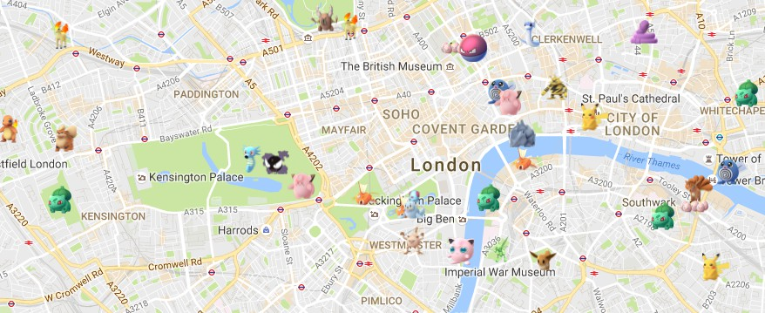
Many important problems are intractable
Tractable problem = Solvable in polynomial time O(n^{k} ) for some k
Finding the shortest route to a Pikachu nest (Dijkstra’s algorithm) vs. finding the shortest tour of all Pokemon nests
Example of intractability: traveling salesperson problem (TSP)
I Input: undirected graph with non-negative edge costs
I Goal: find minimum cost tour visiting every node
I Conjecture: no polynomial-time algorithm for correct solution
I Find an approximate solution instead
13 / 27

Slide 33
Recent advances in TSP
“... [U of Washington researchers] were able to subtract
0.2 billionth of a trillionth of a trillionth of a percent [out of Christofides’ 50% guarantee].”
“This is a result I have wanted all my career,” said David Williamson of Cornell University, who has been studying the traveling salesperson problem since the 1980s.
Quanta Magazine, 8 October 2020.

Slide 34
Greedy knapsack heuristic
Greedy knapsack was incorrect but very fast: O(n log n)
Greedy algorithm:
I Sort items in decreasing bang-for-buck v_{i} /w_{i}
I For each item, pick the item until reach total W
15 / 27

Slide 35
Greedy knapsack heuristic
Greedy knapsack was incorrect but very fast: O(n log n)
Greedy algorithm:
I Sort items in decreasing bang-for-buck v_{i} /w_{i}
I For each item, pick the item until reach total W
How bad is it?
I Example: capacity W =510, three items with values
v = [10, 10, 500], weights w = [10, 10, 501].
15 / 27

Slide 36
Greedy knapsack heuristic
Greedy knapsack was incorrect but very fast: O(n log n)
Greedy algorithm:
I Sort items in decreasing bang-for-buck v_{i} /w_{i}
I For each item, pick the item until reach total W
How bad is it?
I Example: capacity W =510, three items with values
v = [10, 10, 500], weights w = [10, 10, 501].
I “Worst-case scenario”: leave out (a single) extremely valuable object that would fit into knapsack
15 / 27

Slide 37
Better greedy knapsack heuristic
Modified algorithm: pick either the greedy solution or the most valuable item
16 / 27

Slide 38
Better greedy knapsack heuristic
Modified algorithm: pick either the greedy solution or the most valuable item
I Sort items in decreasing v_{i} /w_{i}
I For each item, pick the item until reach total W
I Return either greedy solution or the most valuable item, whichever is better
16 / 27

Slide 39
Better greedy knapsack heuristic
Modified algorithm: pick either the greedy solution or the most valuable item
I Sort items in decreasing v_{i} /w_{i}
I For each item, pick the item until reach total W
I Return either greedy solution or the most valuable item, whichever is better
This gets at least 50% of maximum possible value.
16 / 27

Slide 40
Better greedy knapsack heuristic
Modified algorithm: pick either the greedy solution or the most valuable item
I Sort items in decreasing v_{i} /w_{i}
I For each item, pick the item until reach total W
I Return either greedy solution or the most valuable item, whichever is better
This gets at least 50% of maximum possible value.
I “Worst-case scenario”: greedy leaves out two extremely valuable objects that would both fit into knapsack
I Still pick the better of them: at least 50%
I Often items are small ! the greedy choice cannot leave out many of them
16 / 27

Slide 41
Review
Some problems are inherently intractable
I Knapsack, traveling salesperson
I Greedy algorithms, approximations and heuristics can help
Review exercises
I Knapsack and fantasy football
I Pandas

Slide 42
Today
Greedy algorithms and the knapsack problem
Wrap-up

Slide 43
Wrap-up
Module wrap-up
I What we did
I What we did not do
I What next?

Slide 44
What we did
I Computing
I Programming

Slide 45
Abstraction
Variables, functions, objects
21 / 27

Slide 46
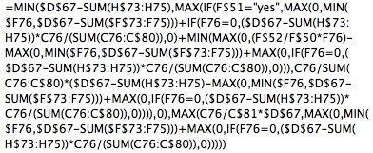
Abstraction
Variables, functions, objects
Source: Quora
21 / 27

Slide 47
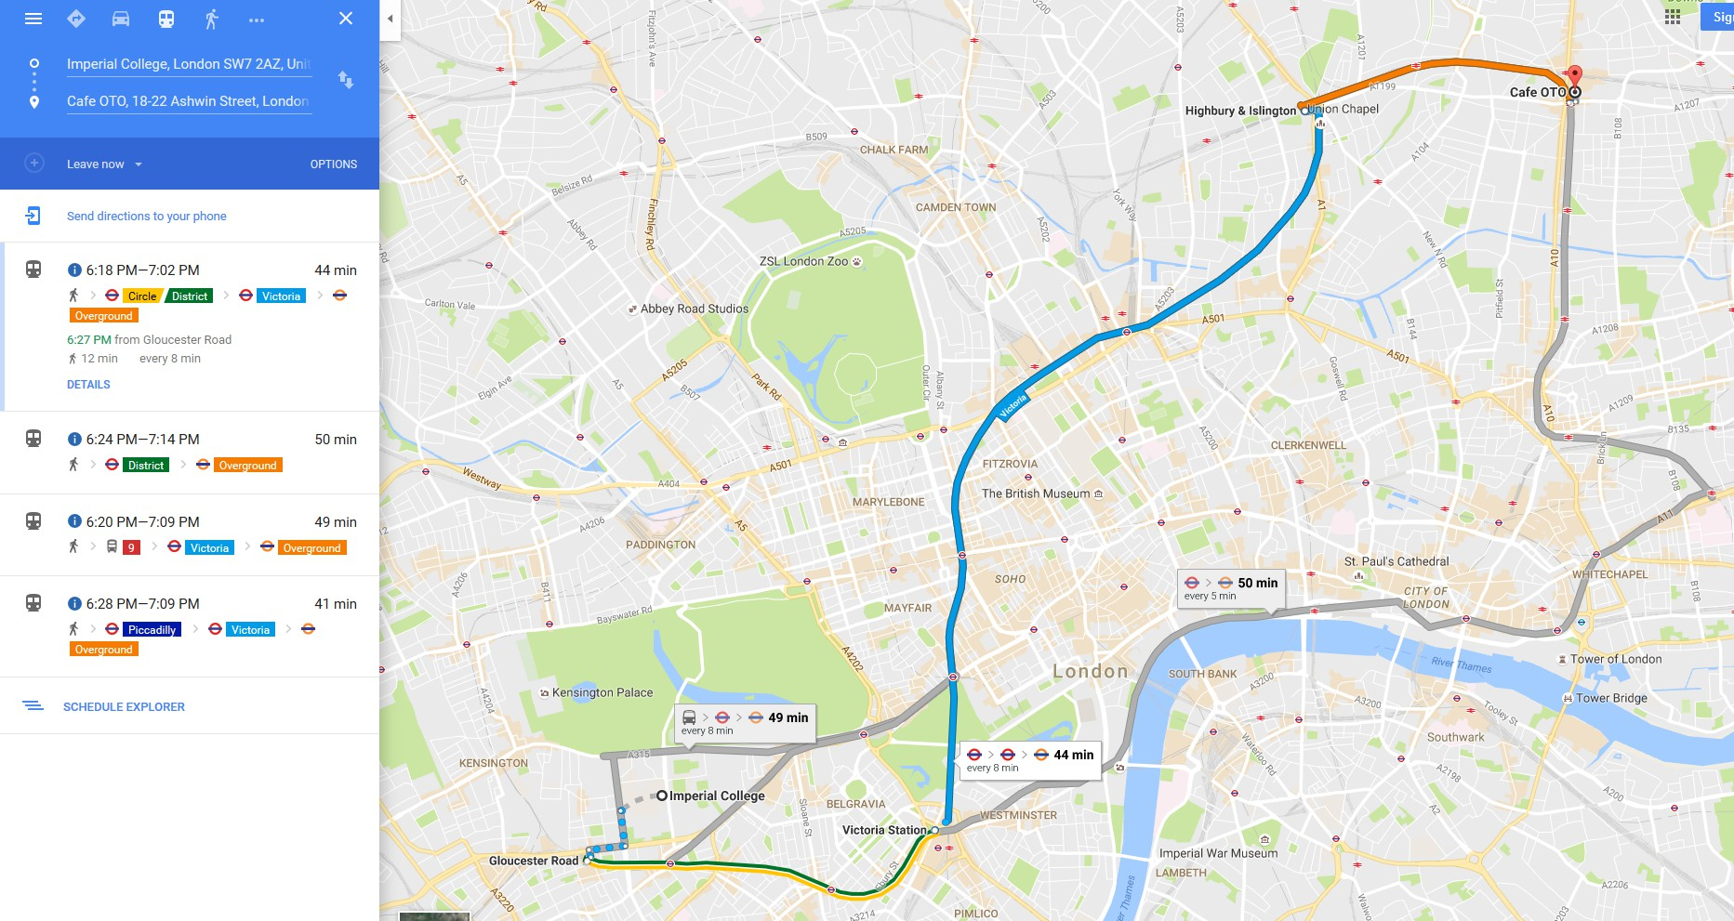
Algorithms
Source: Google maps
Recipes for solving problems

Slide 48
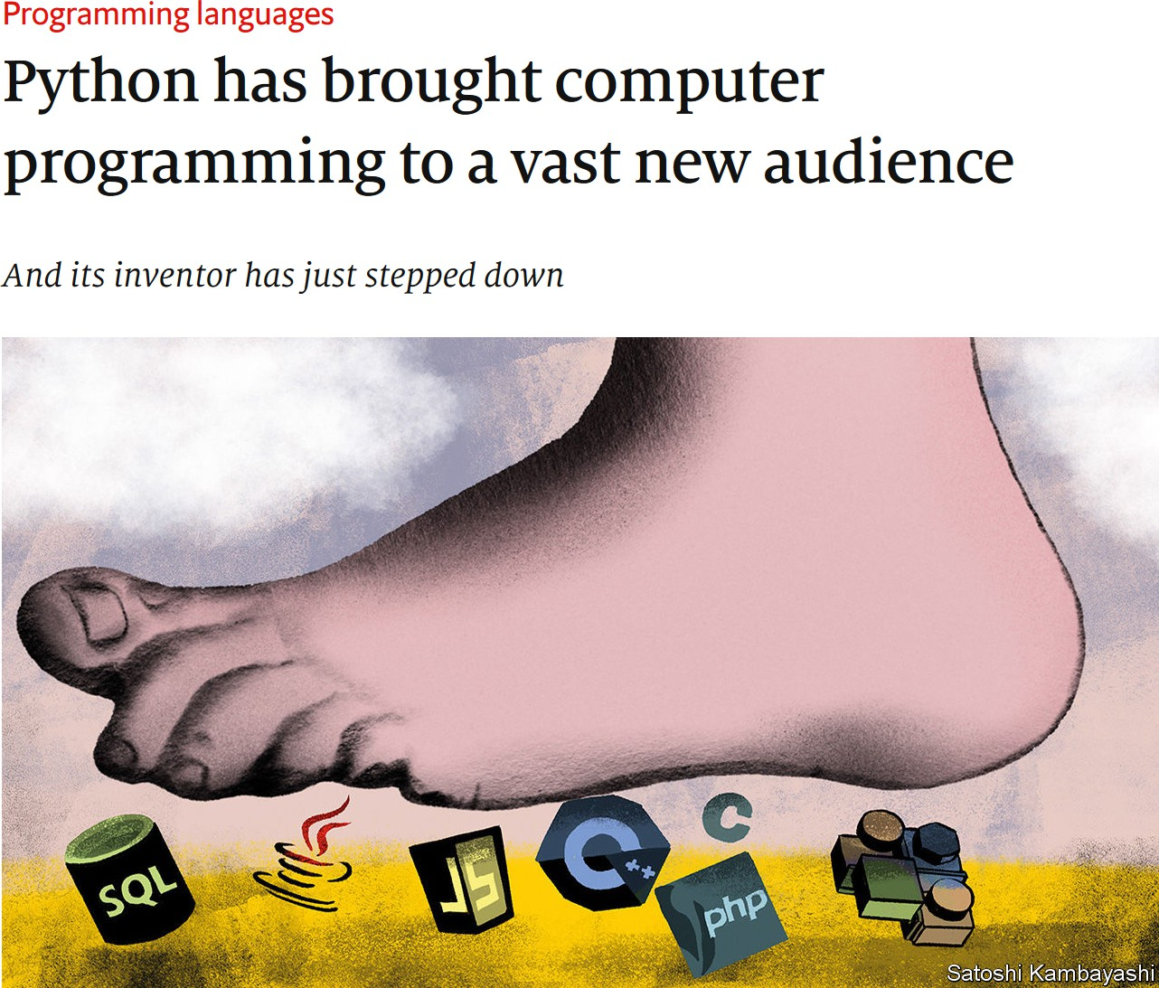
Source: The Economist

Slide 49
Takeaways
Abstraction and algorithm design
I Recipes for problem solving
I Breaking problems into smaller parts: designing functions and classes
24 / 27

Slide 50
Takeaways
Abstraction and algorithm design
I Recipes for problem solving
I Breaking problems into smaller parts: designing functions and classes
Automation with Python
I Accessing and analysing data
24 / 27

Slide 51
Takeaways
Abstraction and algorithm design
I Recipes for problem solving
I Breaking problems into smaller parts: designing functions and classes
Automation with Python
I Accessing and analysing data
Learning a general-purpose programming language
I Future-proofing
I Conversant with engineers
24 / 27

Slide 52
What we did not do
25 / 27

Slide 53
What we did not do
I Business Analytics (!)
25 / 27

Slide 54
What we did not do
I Business Analytics (!)
I Write Python ! ??? ! Result
I Read “Code” by Charles Petzold
25 / 27

Slide 55
What we did not do
I Business Analytics (!)
I Write Python ! ??? ! Result
I Read “Code” by Charles Petzold
I Mathematical proofs
I Many interesting algorithms and data structures...
I “Introduction to Algorithms” by Cormen et al.
25 / 27

Slide 56
Personal use cases
I Flat search in
27 / 27

Slide 57
Personal use cases
I Flat search in London
I Automated various work-related things
27 / 27

Slide 58
Personal use cases
I Flat search in London
I Automated various work-related things
I Analysed an experimental novel using breadth-first search
27 / 27

